Slide 1
Maximising educational opportunities for the Libyan Health sector
Mahdi Gibani MBE
Consultant Nephrologist
BC University Health Board

Slide 2
How to choose a “good” university
Informing the most important decision of a student’s education
Notes:
Employers look at latest qualification (which tends to supersede previous results)
In most skilled professional careers, University provides the latest qualification
I will give you insider information from University marketing personnel and admissions tutors.

Slide 3
Traditional Sources of information:
Research Assessment Exercise (RAE 2008) and
Research Excellence Framework (REF 2014)
www.rae.ac.uk & www.ref.ac.uk
Notes:
The current method you use to assess University quality and consequently where to send students is over simplified, and thus you are restricting educational opportunities for Libyan students”
Many overseas governments use RAE 2008 data to assess University quality and consequently restrict funding to “best” universities.
How it works:
Outputs: Each lecturer submits four best papers published in a five year period, which are rated by peers on a 1* to 4* scale.
Impact: Each School/Department submits case studies that are assessed for ‘reach’ and ‘significance’
Environment: Each School/Department will be assessed in terms of its ‘vitality and sustainability’ for research.
Well done: you are using the most up to date data and the best research is normally completed by the best scientists.
But:
1) Note no assessment of teaching quality at all!
1a) Too intelligent/too busy to teach (away in meetings)? 1b) Do students even access these staff?
2) Note wide variance within institutions – should assess School/Department.
Active? Check news pages/blogs/twitter accounts/paper repository
Assessing quality of research is difficult but a simple way is to look at impact factor of journal that papers are published in (higher number = more citations).
[Insert screen shot of Cardiff medical school with recent discovery.]
2014 being completed now. Published Dec 2014. You should use this from then.

Slide 4
Research Assessment Exercise (RAE 2008)
Notes:
Many overseas governments use RAE 2008 data to assess University quality and consequently restrict funding to “best” universities.
How it works:
Outputs: Each lecturer submits four best papers published in a five year period, which are rated by peers on a 1* to 4* scale.
Impact: Each School/Department submits case studies that are assessed for ‘reach’ and ‘significance’
Environment: Each School/Department will be assessed in terms of its ‘vitality and sustainability’ for research.
Well done: you are using the most up to date data and the best research is normally completed by the best scientists.
But:
1) Note no assessment of teaching quality at all!
1a) Too intelligent/too busy to teach (away in meetings)? 1b) Do students even access these staff?
2) Note wide variance within institutions – should assess School/Department.
Active? Check news pages/blogs/twitter accounts/paper repository
Assessing quality of research is difficult but a simple way is to look at impact factor of journal that papers are published in (higher number = more citations).
[Insert screen shot of Cardiff medical school with recent discovery.]
2014 being completed now. Published Dec 2014. You should use this from then

Slide 5
Traditional Sources of information:
Research Assessment Exercise (RAE 2008) and
Research Excellence Framework (REF 2014)
www.rae.ac.uk & www.ref.ac.uk
Does it tell you all?
No assessment of teaching ability
Only selected staff are submitted!
Most productive = least accessible
Relevance to teaching?
Notes:
Well done: you are using the most up to date data and the best research is normally completed by the best scientists.
But:
1) Note no assessment of teaching quality at all!
1a) Too intelligent/too busy to teach (away in meetings)? 1b) Do students even access these staff?
2) Note wide variance within institutions – should assess School/Department.
Active? Check news pages/blogs/twitter accounts/paper repository
Assessing quality of research is difficult but a simple way is to look at impact factor of journal that papers are published in (higher number = more citations).
[Insert screen shot of Cardiff medical school with recent discovery.]
2014 being completed now. Published Dec 2014. You should use this from then
Many overseas governments use RAE 2008 data to assess University quality and consequently restrict funding to “best” universities.
How it works:
Outputs: Each lecturer submits four best papers published in a five year period, which are rated by peers on a 1* to 4* scale.
Impact: Each School/Department submits case studies that are assessed for ‘reach’ and ‘significance’
Environment: Each School/Department will be assessed in terms of its ‘vitality and sustainability’ for research.
Well done: you are using the most up to date data and the best research is normally completed by the best scientists.
But:
1) Note no assessment of teaching quality at all!
1a) Too intelligent/too busy to teach (away in meetings)? 1b) Do students even access these staff?
2) Note wide variance within institutions – should assess School/Department.
Active? Check news pages/blogs/twitter accounts/paper repository
Assessing quality of research is difficult but a simple way is to look at impact factor of journal that papers are published in (higher number = more citations).
[Insert screen shot of Cardiff medical school with recent discovery.]
2014 being completed now. Published Dec 2014. You should use this from then.

Slide 6
Sources of information: research quality
Notes:
Example of School website

Slide 7
Factors to consider
Quality
Research
International student support
Teaching quality
Extra-curricular
Employability
Facilities
Notes:
Look at the sector/subject Schools/Departments, NOT the University.
Reputation is noticeable in its absence: difficult to quantify objectively; reputation does not always equal student satisfaction.
Often not tangible factors (apart from facilities)
Example: Medicine. Cambridge University 1st in UK for research quality in medicine. University with an international reputation. But ranks 23rd (of only 31) in terms of student satisfaction!

Slide 8
Factors to consider
Quality
Research
International student support
Teaching quality
Facilities
Employability
Extra-curricular
Notes:
Look at the sector/subject Schools/Departments, NOT the University.
Reputation is noticeable in its absence: difficult to quantify objectively; reputation does not always equal student satisfaction.
Often not tangible factors (apart from facilities)
Example: Medicine. Cambridge University 1st in UK for research quality in medicine. University with an international reputation. But ranks 23rd (of only 31) in terms of student satisfaction!

Slide 9
Sources of information: teaching quality
Quality Assurance Agency (QAA) judgments
Confidence > limited confidence > no confidence
Degree accreditation
Key Information Set: www.unistats.direct.gov.uk
Notes:
QAA for University (not School)
Degree accreditation: E.g. British Psychological Society; British Association of Sport and Exercise Scientists; British Dietetics Society; Institute of Chartered Physiotherapists;

Slide 10
Sources of information: teaching quality
The teaching on my course
1. Staff are good at explaining things.
2. Staff have made the subject interesting.
3. Staff are enthusiastic about what they are teaching.
4. The course is intellectually stimulating.
Assessment and feedback
5. The criteria used in marking have been clear in advance.
6. Assessment arrangements and marking have been fair.
7. Feedback on my work has been prompt.
8. I have received detailed comments on my work.
9. Feedback on my work has helped me clarify things I did not understand.
Academic support
10. I have received sufficient advice and support with my studies.
11. I have been able to contact staff when I needed to.
12. Good advice was available when I needed to make study choices.
Organisation and management
13. The timetable works efficiently as far as my activities are concerned.
14. Any changes in the course or teaching have been communicated effectively.
15. The course is well organised and is running smoothly.
Learning resources
16. The library resources and services are good enough for my needs.
17. I have been able to access general IT resources when I needed to.
18. I have been able to access specialised equipment, facilities, or rooms when I needed to.
Personal development
19. The course has helped me to present myself with confidence.
20. My communication skills have improved.
21. As a result of the course, I feel confident in tackling unfamiliar problems.
22. Overall I am satisfied with the quality of this course
Notes:
Student satisfaction
Institutions are investing millions to enhance student satisfaction.
Independently run online and phone yearly survey of third year students. 22 questions; answer on 1 to 5 ??completely disagree to completely agree??.
Grade point average (GPA) – between 1 and 5 (4 and above is good).
Or % of students who agree.
NB Students have no comparator; results can be effected by expectations (expect it to be good – so rate poorly when surprised it isn't’!) and engagement (don’t turn up to lectures – do poorly – rate poorly!)
Nevertheless it is students’ up-to-date perception and best objective indicator we have at present.

Slide 11
Sources of information: teaching quality
Notes:
Key Information Set: www.unistats.direct.gov.uk
Explain tabs

Slide 12
Factors to consider
Quality
Research
International student support
Teaching quality
Facilities
Employability
Extra-curricular
Notes:
Look at the sector/subject Schools/Departments, NOT the University.
Reputation is noticeable in its absence: difficult to quantify objectively; reputation does not always equal student satisfaction.
Often not tangible factors (apart from facilities)
Example: Medicine. Cambridge University 1st in UK for research quality in medicine. University with an international reputation. But ranks 23rd (of only 31) in terms of student satisfaction!

Slide 13
Sources of information: international student support
Make a subjective assessment from School/Department’s (dedicated) website
Finance/visas
English language training
Accommodation
International student representatives
Peer Guides
Meet and greet
Notes:
You have a right to ask for support – fees typically 25% higher.
Dedicated website = international students and needs integrated into curriculum and University structure
Dedicated staff member to support paying of fees/interactions with UK Border Agency/extending of visas
Extended degrees for English language experience
Accommodation office catering to international needs (e.g. family options; wifi)
International reps sitting on student staff forums/student union
Peer guide and international student advisor schemes [see pic of guides in yellow]
Meet and greet (airport pick up; visits/transport to local attractions)
Transition challenges faced by international students
New place to live and learn
Integration into the new learning and teaching context
Expectations vs reality
Successes and barriers in forming multi-cultural relationships
Different cultural norms including study and socialising
Language, especially academic English
Feeling of being ‘outsiders’
Work / study balance, need for careers advice
Transition challenges faced by international students
Commonalities but also fundamental differences:
Universities’ profile – teaching or research focused / partnerships abroad or agents
Different support at different Universities
Roles of academics (Director of Studies / Personal Development Tutor)
Student associations – status, role in students’ journey
Profile of students – PG or UG, where from, level of English
‘International’ – different nationalities and differences within nationalities.

Slide 14
Factors to consider
Quality
Research
International student support
Teaching quality
Facilities
Employability
Extra-curricular
Notes:
Look at the sector/subject Schools/Departments, NOT the University.
Reputation is noticeable in its absence: difficult to quantify objectively; reputation does not always equal student satisfaction.
Often not tangible factors (apart from facilities)
Example: Medicine. Cambridge University 1st in UK for research quality in medicine. University with an international reputation. But ranks 23rd (of only 31) in terms of student satisfaction!

Slide 15
Factors to consider
Quality
Research
International student support
Teaching quality
Extra-curricular
Employability
Facilities
Notes:
Look at the sector/subject Schools/Departments, NOT the University.
Reputation is noticeable in its absence: difficult to quantify objectively; reputation does not always equal student satisfaction.
Often not tangible factors (apart from facilities)
Example: Medicine. Cambridge University 1st in UK for research quality in medicine. University with an international reputation. But ranks 23rd (of only 31) in terms of student satisfaction!

Slide 16
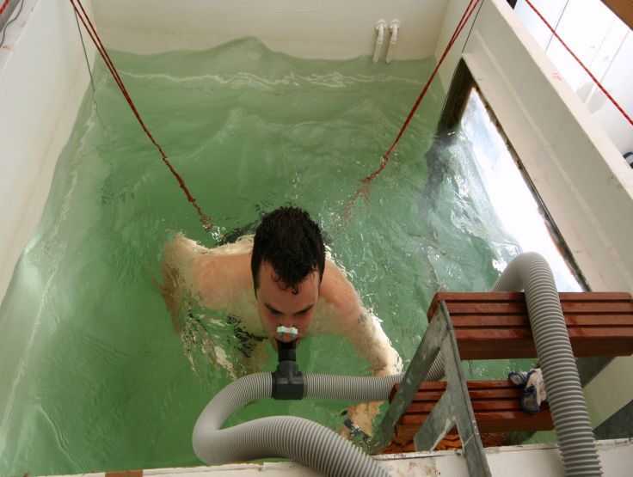
Sources of information: facilities
Notes:
Definitely need to visit. Or use virtual tours.
Science/medicine/allied health: laboratories and close links to NHS
NB Check access for students & number of technicians!
Computing and library (interactive learning spaces)
Lecture rooms – good IT and atmosphere?

Slide 17
Factors to consider
Quality
Research
International student support
Teaching quality
Extra-curricular
Employability
iFacilities
Notes:
Look at the sector/subject Schools/Departments, NOT the University.
Reputation is noticeable in its absence: difficult to quantify objectively; reputation does not always equal student satisfaction.
Often not tangible factors (apart from facilities)
Example: Medicine. Cambridge University 1st in UK for research quality in medicine. University with an international reputation. But ranks 23rd (of only 31) in terms of student satisfaction!

Slide 18
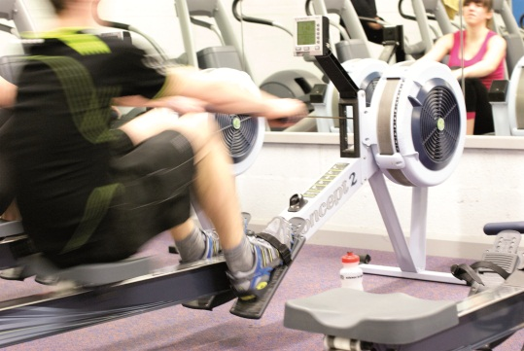
Sources of information: extracurricular
Notes:
Again, definitely need to visit. Or use virtual tours.
Students Union [see picture of new Bangor]
Clubs and Societies – should be free! Sport and others (e.g. chess, dramatics, scouts)
Sport: gyms, sporting facilities.
Arts: theatre, cinema, dance, galleries.
History: world heritage sites.
Social: cafes and clubs
Food: onsite cafes, shops.
Accommodation – designed for international market? (Walking distance, wifi, guaranteed for first year?)
Athletic Union.
Culture/religion. (BIC&BIS)...
A full programme of events such as music, drama, aerial theatre, comedy, film and a range of other activities will be held there

Slide 19
Sources of information: extracurricular
Notes:
British countryside: not in London!

Slide 20
An overall picture of “quality” The league tables
☺☺
��
££
Notes:
League tables
Again, look at School/Department as well (instead of) University
Must be taken with a pinch of salt.
The Complete University Guide (free; www; The Independent); The Times (subscribers only; online and in print); The Guardian (free; www; in print).

Slide 21
Questions to ask in person
What is your student to staff ratio?
How many of your research staff teach?
What training do your lecturers and postgraduate teachers receive?
How are students taught and assessed?
How much contact time is there and how is this split between lectures/seminars/tutorials/labs?
How many international students are there?
What support do you offer struggling and excelling international students?
Notes:
To teach in Higher Education you do not need any formal qualification.
How many lecturers have teaching qualifications?
Big class sizes are a feature of higher education. As is self-guided learning. What support is available outside of formal lectures?
Look for varied teaching (not just lectures) e.g. seminars, labs.
Look for varied assessments (not just closed book exams).

Slide 22
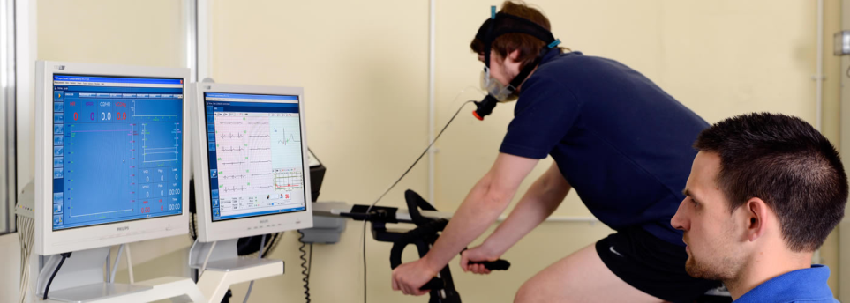
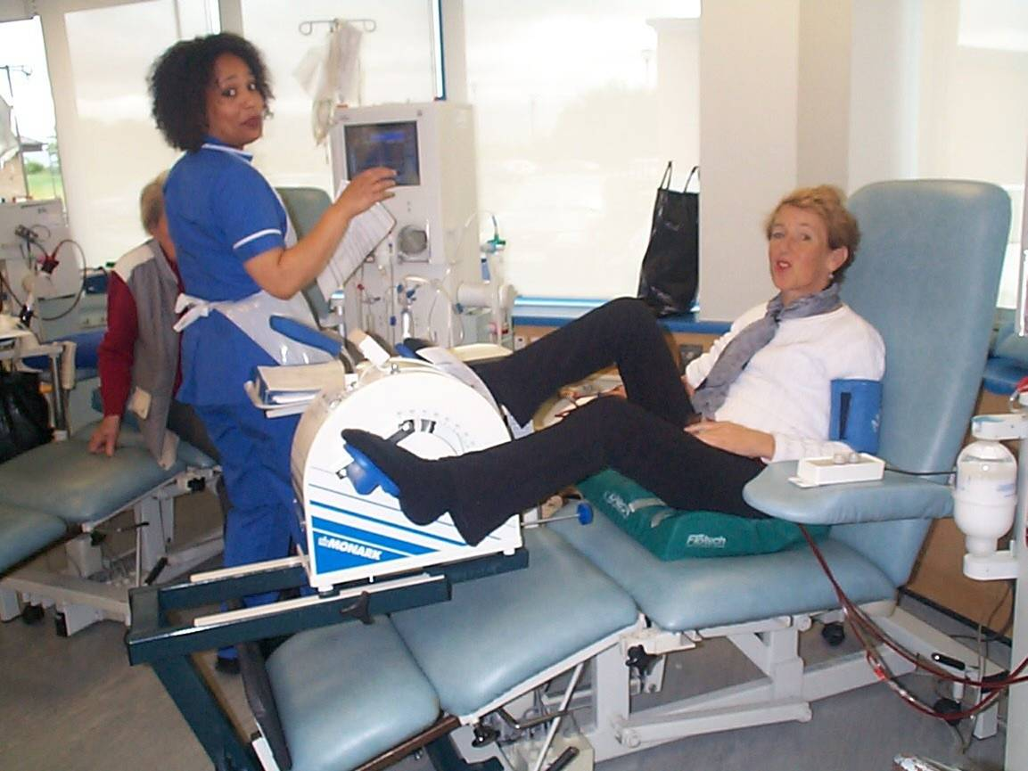
Sports Sciences
Amateur and elite sport
Rehabilitation
Injury
Disease
Physical activity for health
(DM, osteoporosis, etc)
Areas of Study
Health Studies
Nursing
Radiography
Occupational therapy
Physiotherapy
Public health and health promotion
Advances in health practice
Health and social care leadership
Medical Sciences
Biological Sciences
Biotechnology, genetics and biomedical
Chemistry
Industrial & organic
Psychology
Clinical
Notes:
E.g. nursing
Look for two year accelerated programmes to upgrade diplomas to BSc
Should develop evidence based practice and leadership skills
Check placements/observations
Medical Sciences (progression agreements: e.g. Bangor BMedSci to Cardiff MBBCh Medicine)
Environmental Sciences
Agriculture, Forestry and Sustainability
Business
Management, Banking & Finance, Islamic
Finance, Marketing
Computer Science
AI & Internet Security
Electronics
Telecoms
Law
LLB & LLM International/Commercial
Journalism & Creative Writing
Literature, Linguistics, Media and
Film
Modern Languages
Music
Ocean Sciences
Marine Biology and Protection
AI: artificial intelligence

Slide 23
Thank you
شكرا
Notes:
Libyan students have much to offer UK universities, beyond their fees. They can enhance the multi cultural diverse university environment, enhancing educational opportunities and attractiveness of a university to all its students. Although self guided learning is required, expect quality and support. Look beyond reputation and London to maximize educational opportunities.

Slide 25
What to study
Higher Education subjects to address Libya’s clinical needs
Notes:
Employers look at latest qualification (which tends to supersede previous results)
In most skilled professional careers, University provides the latest qualification
I will give you insider information from University marketing personnel and admissions tutors.

Slide 26
Factors to consider
Quality
Research
International student support
Teaching quality
Facilities
Employability
Extra-curricular
Notes:
Look at the sector/subject Schools/Departments, NOT the University.
Reputation is noticeable in its absence: difficult to quantify objectively; reputation does not always equal student satisfaction.
Often not tangible factors (apart from facilities)
Example: Medicine. Cambridge University 1st in UK for research quality in medicine. University with an international reputation. But ranks 23rd (of only 31) in terms of student satisfaction!

Slide 27
Sources of information: employability
Vocational qualifications
Degree accreditation
Statutory requirements of profession
Personal Professional Development
Needs assessments > goal setting > reflective practice
Transferable skills
Writing, presentation, numeracy, teamwork, analytical, Information Technology
Application of knowledge
Work placements
Practical examples
www.unistats.direct.gov.uk: % employed and starting salary
Notes:
Skills training for today vs. learning to learn for entire career
BPS – phase 1: undergraduate degree > phase 2: masters degree > experience = charted status.

Slide 28
Sources of information: employability
Notes:
www.unistats.direct.gov.uk

Slide 29
An overall picture of “quality”
www.thecompleteuniversityguide.co.uk
Notes:
Student satisfaction (you now know but note fudge factor in this example (not including facilities))
Entry standards (not necessarily an indicator of quality; possibly of popularity)
Research assessment: you now know (but look at for REF from next year).

